Slide 1
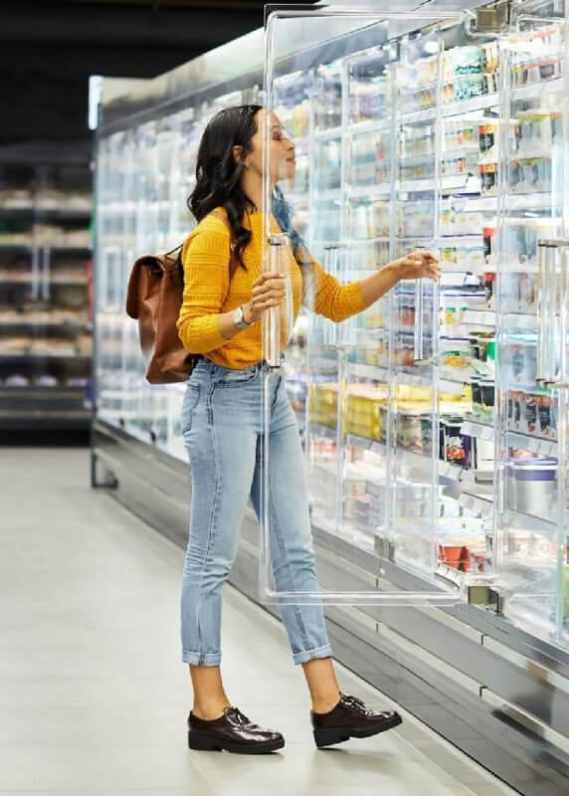
Hack-A-Stat | 2025
Hackathon Solutions
Code Brigade
Tanmay Nikam | Yash Gadhave | Sagar Yadav
86092400065 | 86092400081 | 86092400086
B012 | B027 | B32

Slide 2
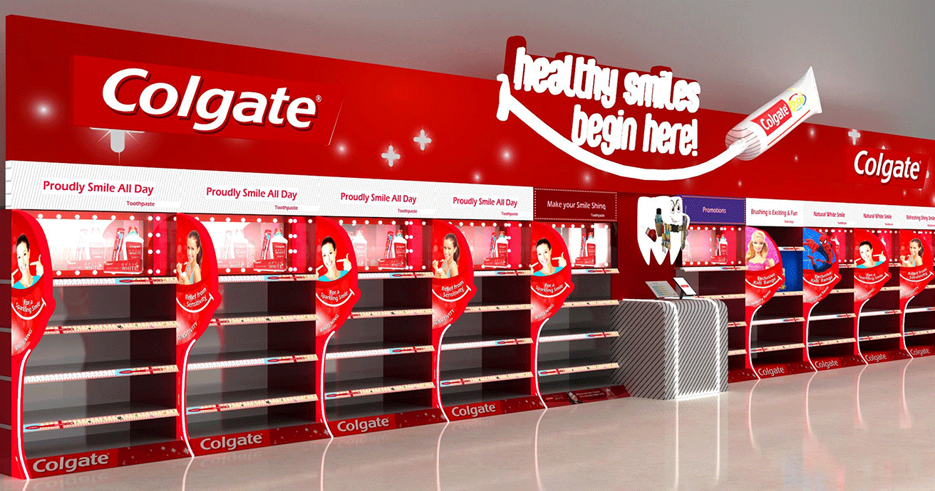
Retail Shelf Optimization | PS I

Slide 3
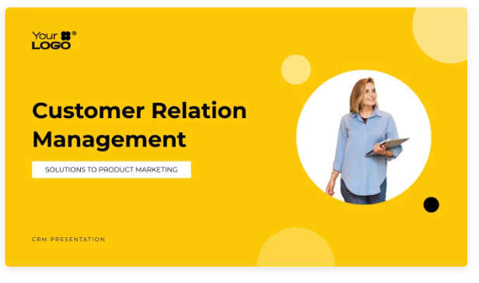

Problem Statement I
Optimization
Develop a tool to optimize product shelf allocation on limited retail shelf space
considering factors like product popularity, seasonality, and profit margins to maximize sales and profitability

Slide 4

1
RandomForestRegressor
Mean Squared Error: 1234.56
R-squared: 0.85
Best fitness (Total Profit): 78901.23
Key
Insights
2
Genetic Algorithm
Best Fitness (Total Profit): 78901.23

Slide 5
models used
1
2
3
RandomForestRegressor
Predicts product popularity (Regression).
Prophet
Analyzes and predicts seasonal variations in sales (Time Series Forecasting).
Genetic Algorithm
Optimizes shelf allocation for maximum profit (Optimization).

Slide 6
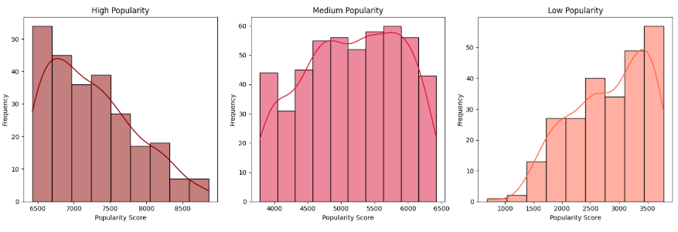
Popularity Scores

Slide 7
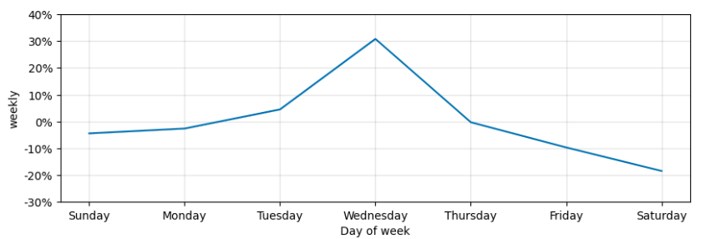
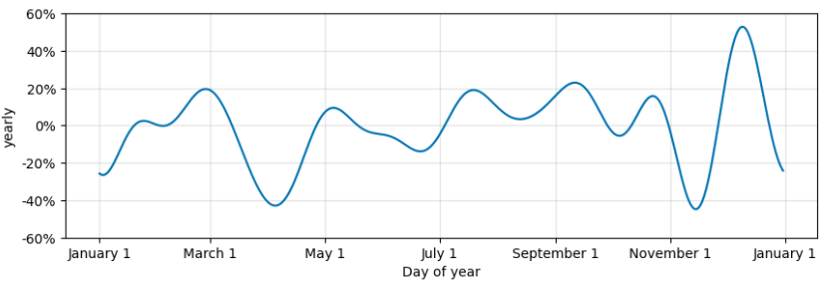
Seasonal Variance Analysis

Slide 8
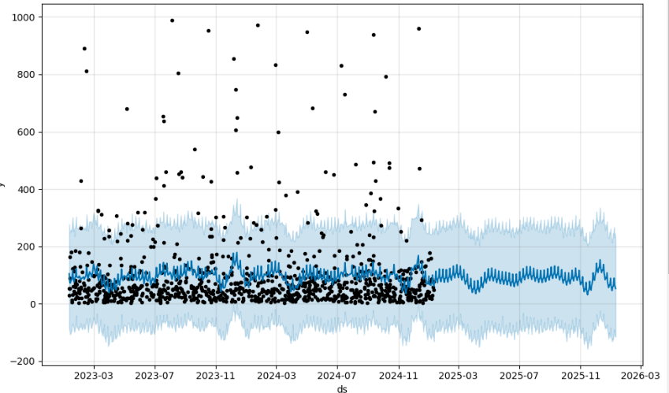
Seasonal Variance Analysis

Slide 9
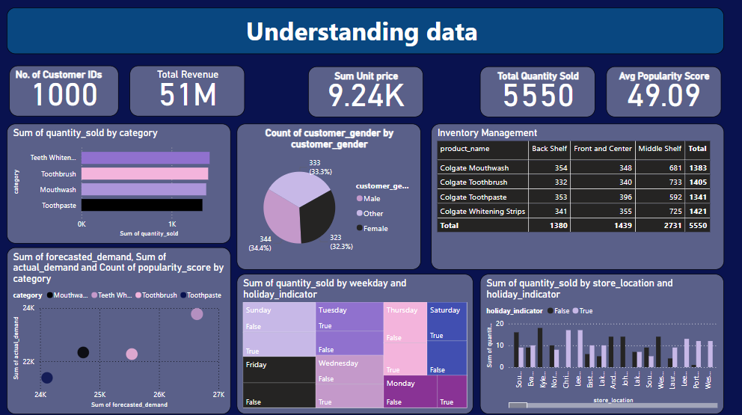

Slide 10
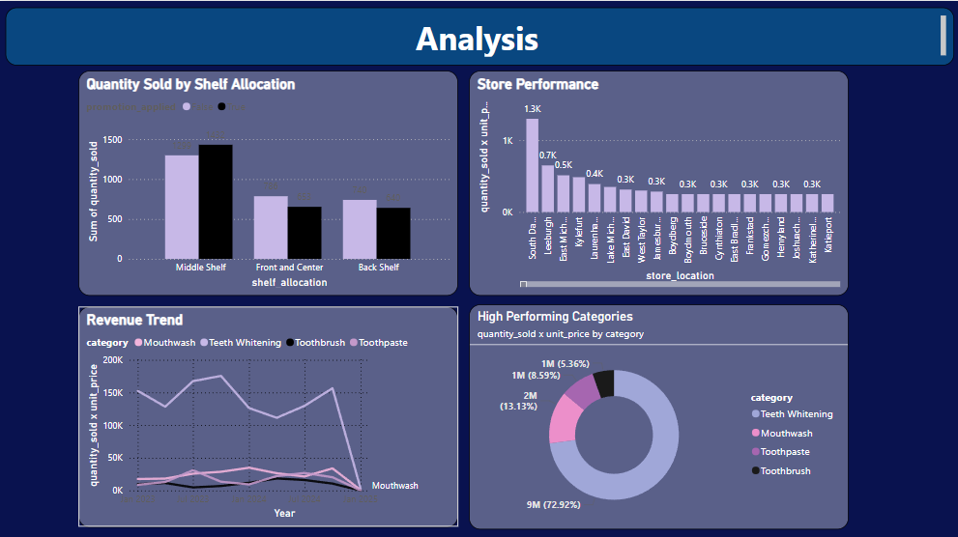

Slide 11
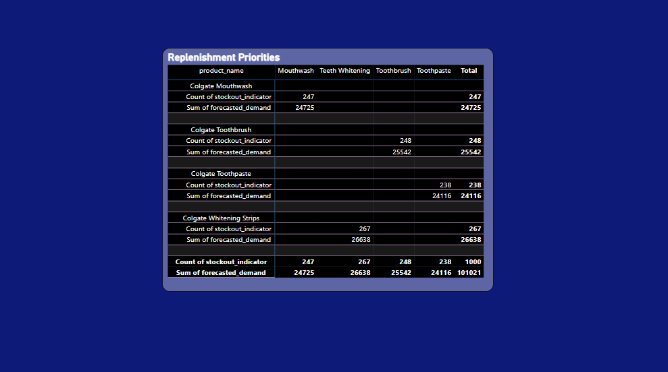

Slide 12
Problem Statement II
Marketing Strategy
Data analytics & insights in Global Toothpaste market
Analyze toothpaste sales data from top subsidiaries across four countries to help Colgate optimize marketing strategies.

Slide 13
1
A Random Forest Classifier is trained on the data to predict missing values in the 'CP SUB BRAND' column, leveraging the relationships between other features to estimate the most likely values.
The model's predictions are used to fill the remaining null values in the 'CP SUB BRAND' column.
Data
cleaning

Slide 14
1
The function uses the Interquartile Range (IQR) method to define outlier boundaries.
Outliers are replaced with the median value of the respective column.
Box plots are generated to visualize the data before and after outlier correction.
The remaining extreme values, not considered errors, are acknowledged as potentially valid based on domain knowledge.
Outliers

Slide 15
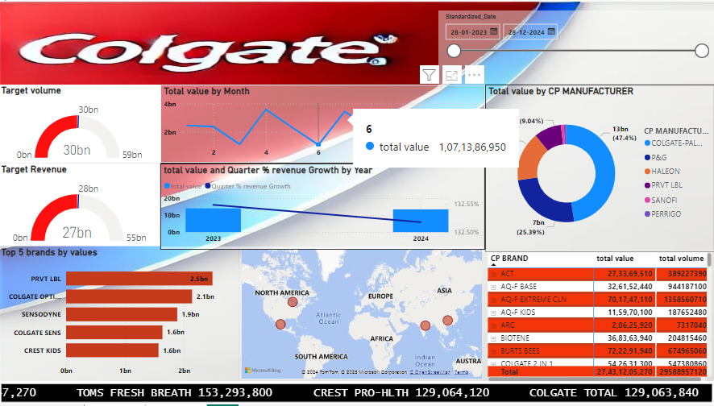

Slide 16
1
Total Volume and Target Volume (Gauge Chart)
Data:
Achieved: 30 billion units.
Target: 59 billion units.
Insights:
The total volume achieved is approximately 50.8% of the target.
Scope for improvement in production or sales performance.
Measures

Slide 17
2
Total Revenue and Target Revenue (Gauge Chart)
Data:
Achieved: 27 billion.
Target: 55 billion.
Insights:
The total revenue achieved is about 49% of the target.
A focus on revenue growth strategies is essential to bridge the gap.
Measures

Slide 18
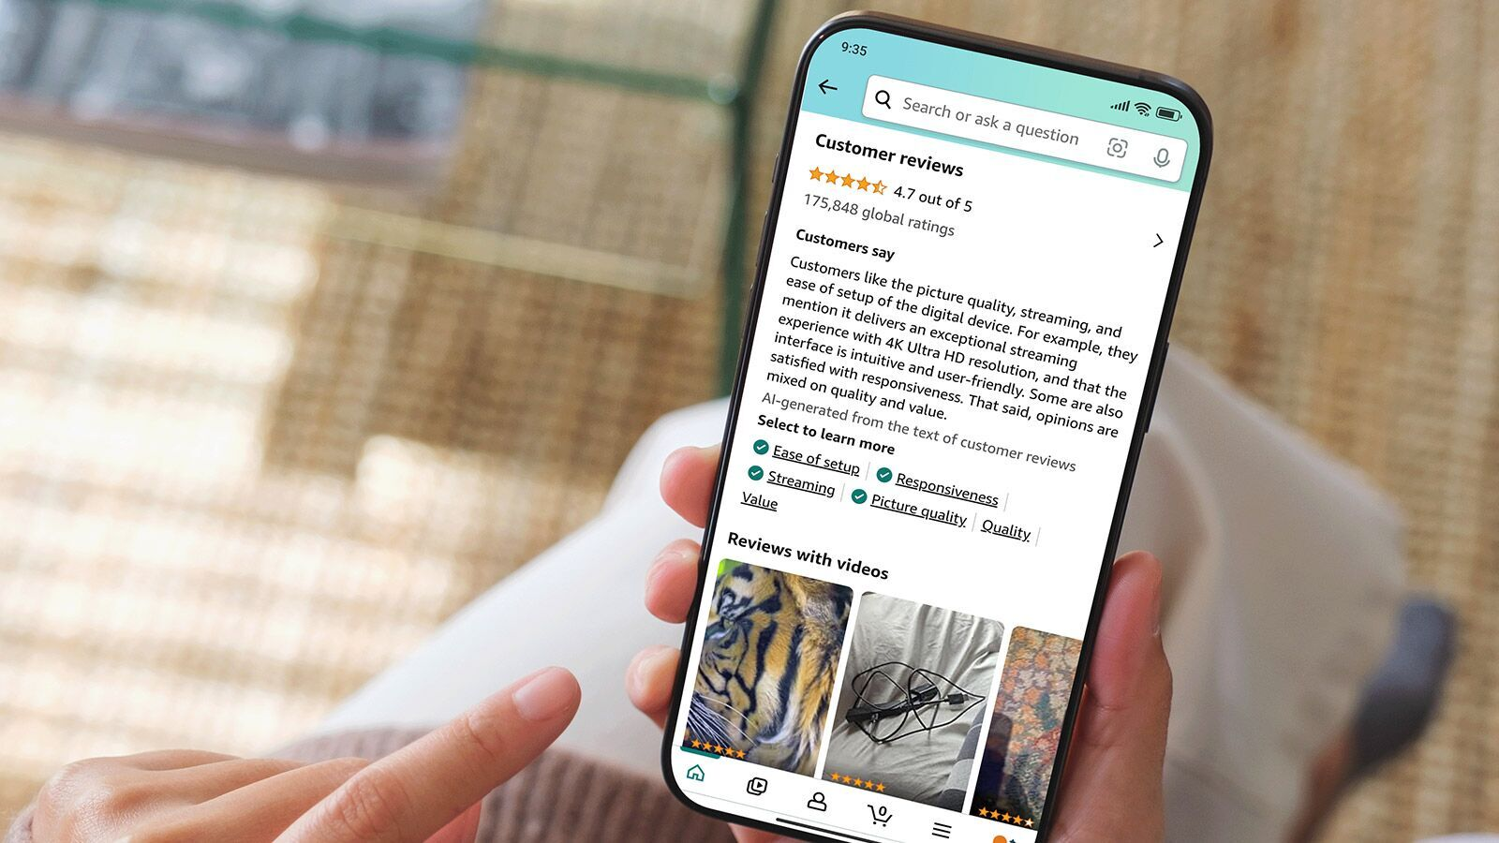
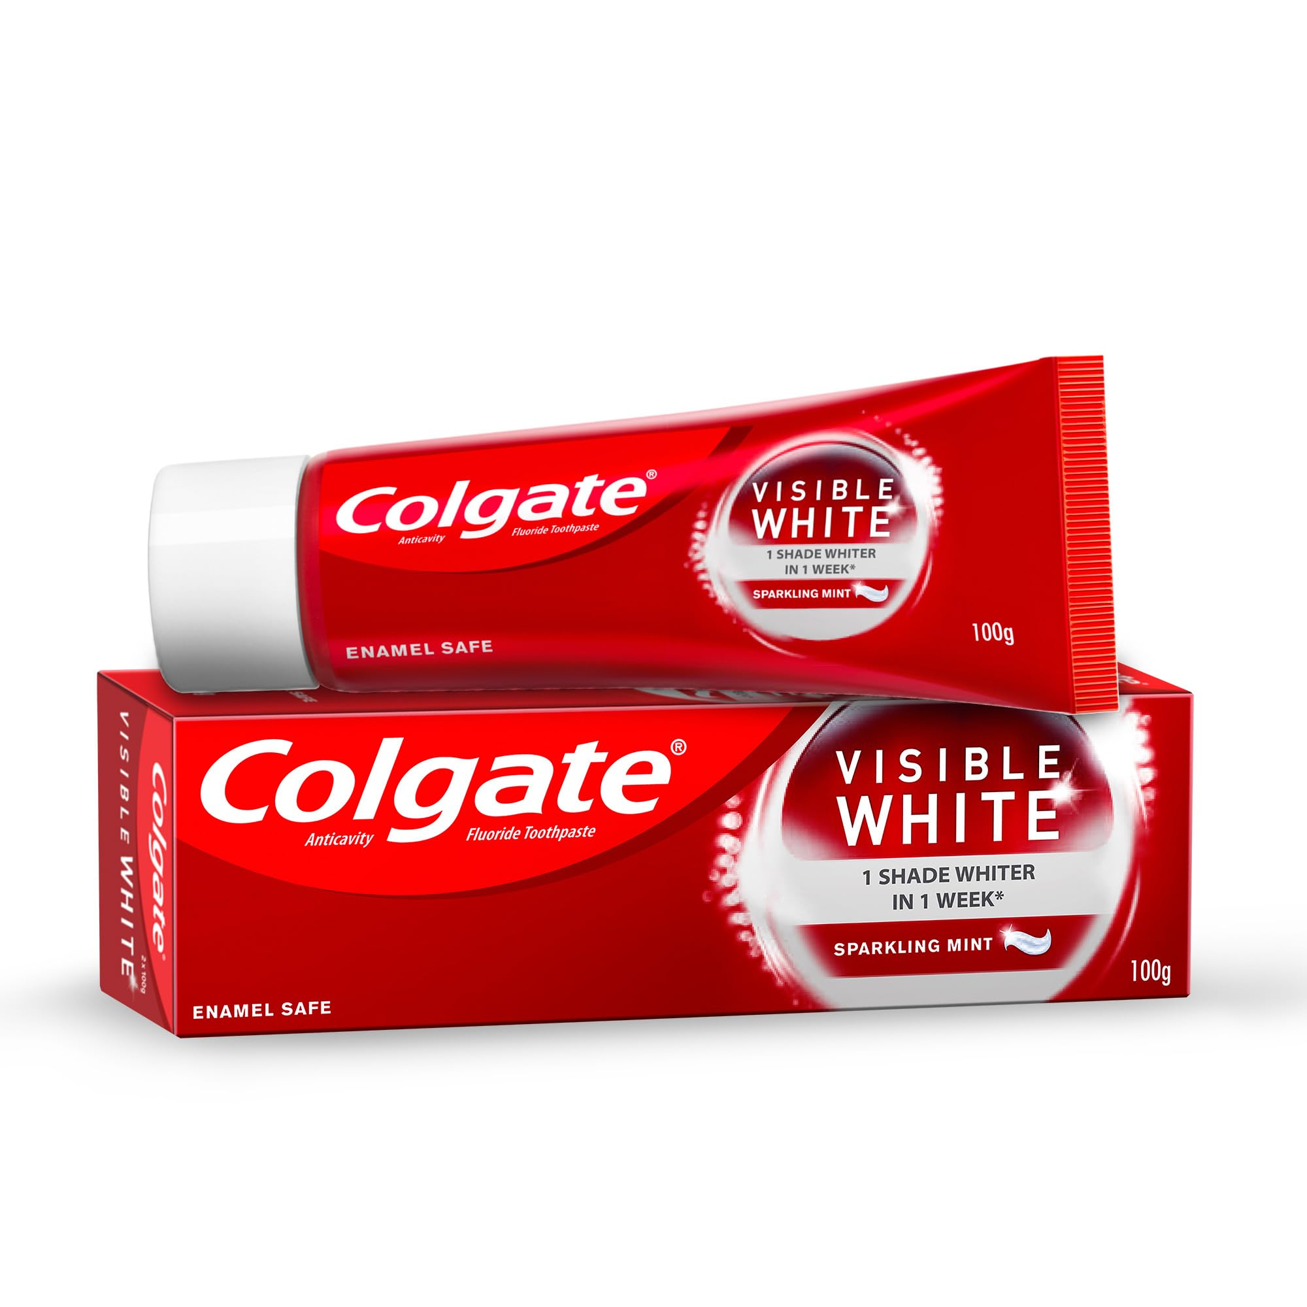
Amazon Oral Care Customer reviews
| sentiment analysis

Slide 19
Problem Statement III
Sentiment Analysis
Sentiment analysis & topic modeling for Amazon Customer Feedback
Build a machine learning or NLP-based tool providing actionable insights for consumers and sellers

Slide 20
models used
1
2
3
VADER (Valence Aware Dictionary and sEntiment Reasoner)
This is a lexicon and rule-based sentiment analysis tool. It's used to calculate sentiment scores (positive, negative, neutral, and compound) for text data.
RoBERTa (Robustly Optimized BERT Pre Training Approach)
This is a transformer-based model for sentiment analysis, specifically the
cardiffnlp/twitter-roberta-base-sentiment variant, fine-tuned for sentiment analysis on Twitter data
NMF (Non-negative Matrix Factorization)
A Statistical modeling technique used to view top keywords associated with each topic are extracted to understand the underlying themes.

Slide 21
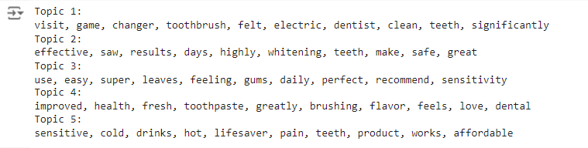
1
NMF
Key
Insights
2
Vader

Slide 22
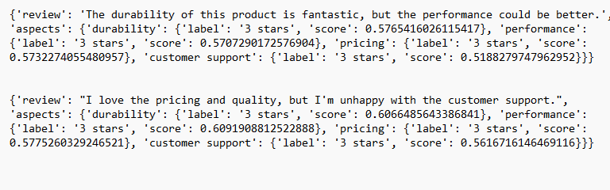
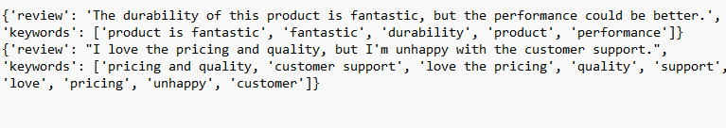
Aspect Based
Keyword Extraction

Slide 23
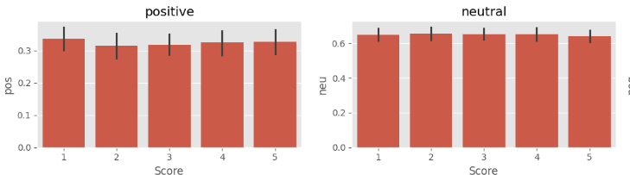
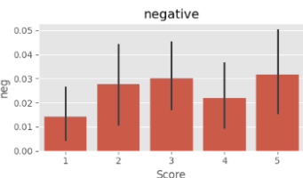
Vader Scores | pos neu neg

Slide 24
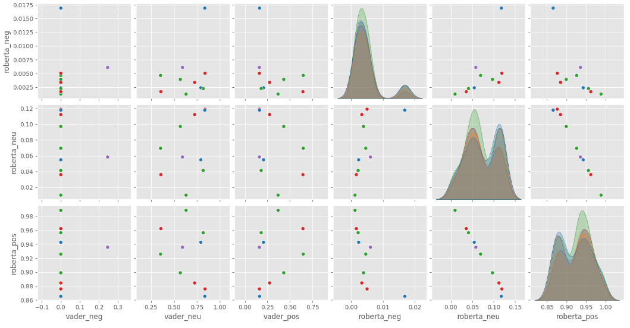
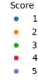
RoBERT Pairplots

Slide 25
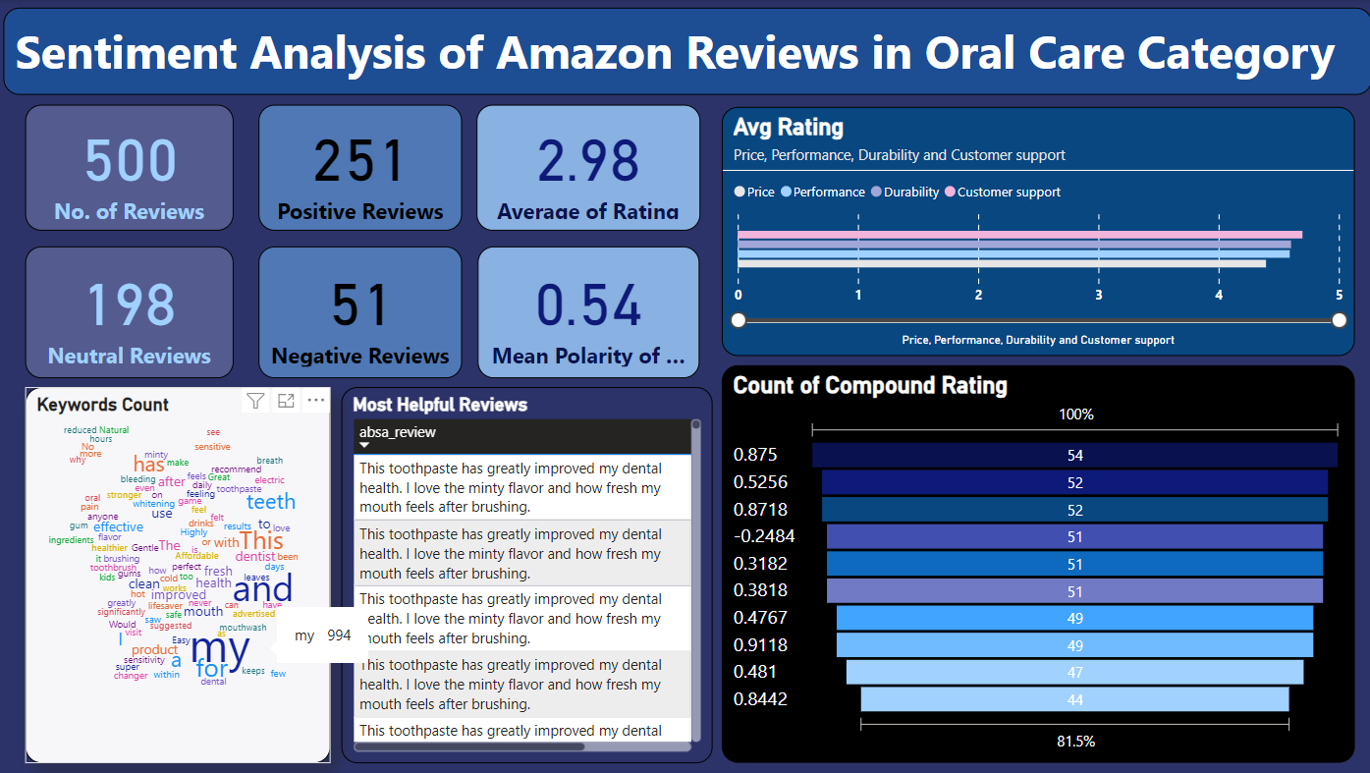

Slide 26
thank you

